Slide 1
Business Opportunities with KORUA FTA
Han Dong-man
Consul General
of the Republic of Korea
In San Francisco

Slide 2
Contents
Part 1 : Korea Now
Part 2 : Korea-U.S. Alliance
Part 3 : KORUS FTA

Slide 3
Part 1. Korea Now

Slide 4
Korean Economy
Korean Economy?
15th largest of the world in terms of GDP
7th largest trading partner of USA
8th largest trading nation of the world
Korean Industry?
80% of world’s LNG carrier
World’s No. 1 in cell phone
World’s No. 5 in passenger cars

Slide 5
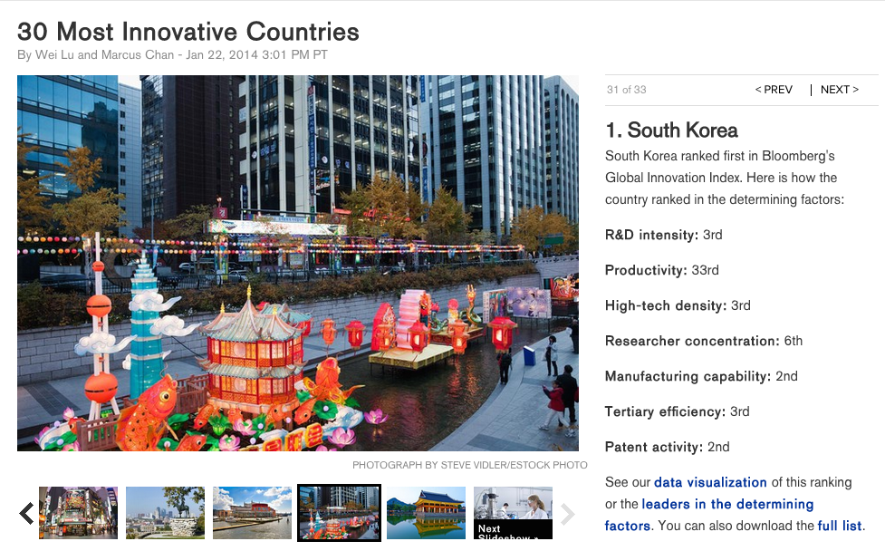
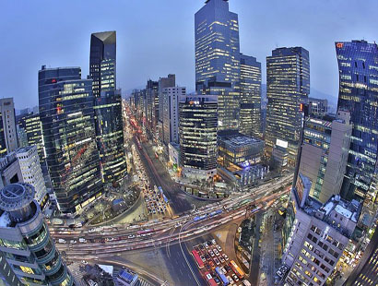
Korea : #1 World Class Innovation

Slide 6
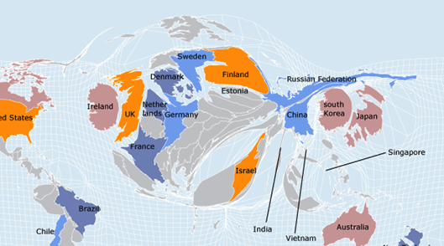
Korea : World Map of Innovation
Source: Harvard Business Review

Slide 7
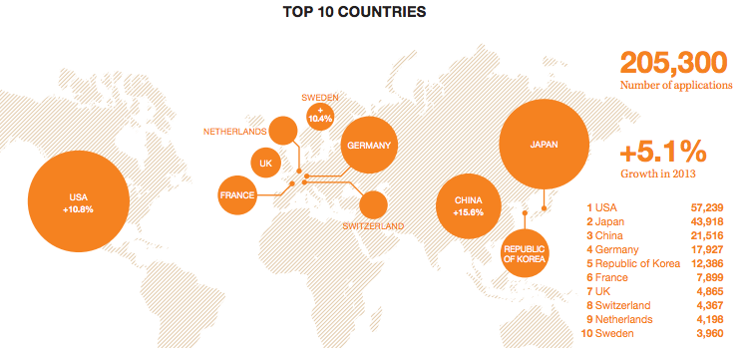
Korea : Number 5 Patent country
For universities, the KAIST (Korea Advanced Institute of Science and Technology) was ranked 7th with 105 filings, as the only non-U.S. educational institution in the coveted top 10 rankings.

Slide 8
Korea : US$1 trillion Trade Club
9th Nation to join a group of nations to surpass international trading volume of US$1 trillion
United
States
China
Germany
Japan
Netherlands
France
United
Kingdom
Korea
Hong Kong
Italy
Year of Membership | 1992 | 2004 | 1998 | 2004 | 2007 | 2006 | 2006 | 2011 | 2012 | 2007
2012 Trade Volume (US$ bn)
Source: WTO
Notes:
Another feat of achievement accomplished by Korea is that our international trade volume surpassed a total of 1 trillion US dollars in 2011.
Only 8 nations have accomplished this prior to Korea.
Korea became one of only 15 in the world with a GDP of over $1 trillion.

Slide 9
Korea : Creative Economy “Eureka!”
Eureka!
‘I have it’
‘I have found it’

Slide 10
Korea : Creative Economy
Future Engine (6T) for Korea by 2020-2030
IT
BT
NT
Information Technology
Bio
Technology
Nano
Technology
Future Engine (6T)
ET
ST
CT
Environment
Technology
Space
Technology
Culture
Technology

Slide 11
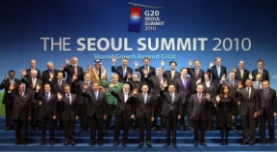
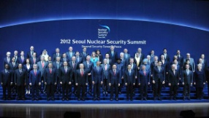
Korea : Global Footprint
2010
2011
2012
2013

Slide 12
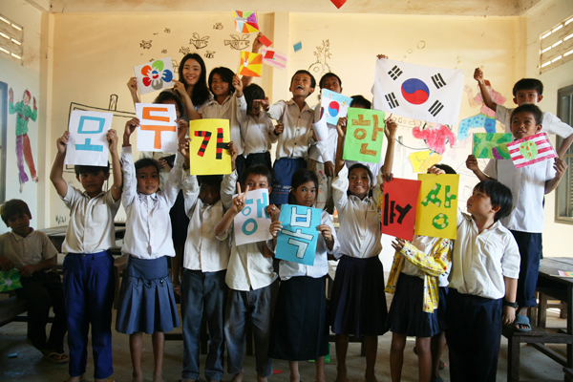
Korea : Aid Receiving to Aid Giving
In 2010, the Republic of Korea (Korea) joined the prestigious Development Assistance Committee(DAC) of the OECD. Korea is the only country to have ever moved from being a recipient of international development assistance to a donor and DAC member.
Source: Koica.go.kr
(Korea International Cooperation Agency)
In 2012, Korea had the largest increase in Official Development Assistance(ODA) among the DAC at 17%. Most DAC membered decreased their ODA, in fact, Korea’s ODA from 2009 to 2012 increased over 90%

Slide 13
Part 2. Korea-U.S. Alliance

Slide 14
Korea-U.S. Alliance : Sharing Value
SECURITY
TRADE & ENERGY
KOR-US
GLOBAL PARTNERSHIP
Sharing Value
Sharing Value
CULTURE
PEOPLE-TO-PEOPLE

Slide 15
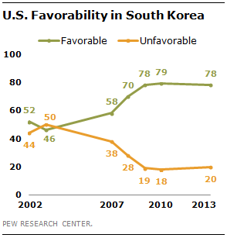
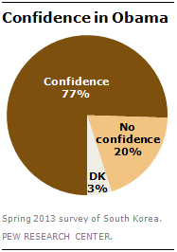
Korea-U.S. Alliance
“South Koreans remain strongly pro-American”
(May 6, 2013)
Source: PEW Research Center

Slide 16
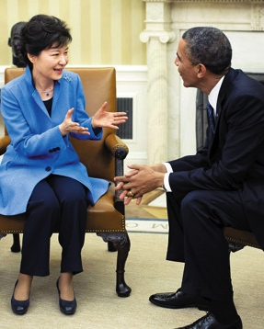
Korea-U.S. Alliance: Summit
Established personal trust and bond between the two leaders
Delivered a firm message to North Korea
Secured support for the ‘Korean Peninsula Trust-Building Process’ and enhanced the understanding for the ‘Northeast Asia Peace Cooperation Plan’
Revise Civil Nuclear Energy Cooperation Agreement/ transfer of wartime control/ provided political impetus for the reciprocal pursuit of major pending issues such as professional visa quota

Slide 17
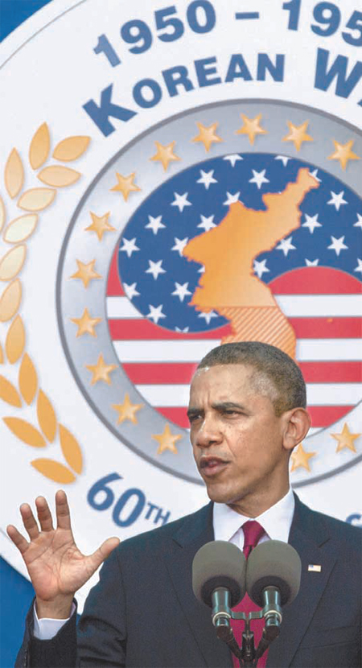
Korea-U.S. Alliance: Korean War Armistice
“Here, today, we can say with confidence that war was no tie. Korea was a victory.”
“When 50 million South Koreans live in freedom - a vibrant democracy, one of the world’s most dynamic economies, in stark contrast to the repression and poverty of the North - that’s a victory; that’s your legacy.”
-President Obama at 60th Anniversary of the Korean War Armistice (Jul 27, 2013)

Slide 18
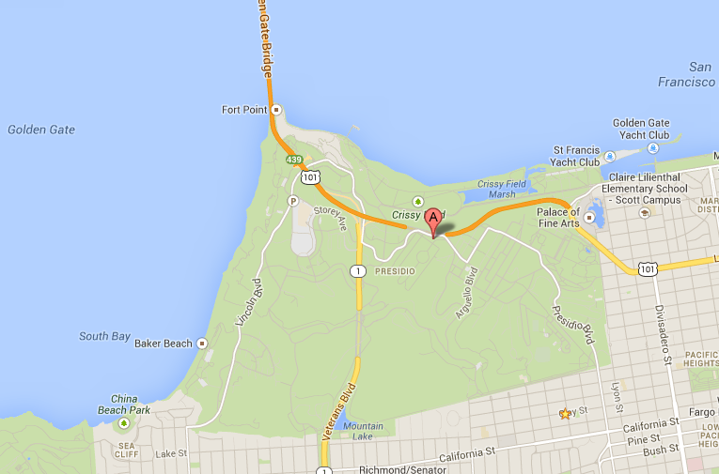
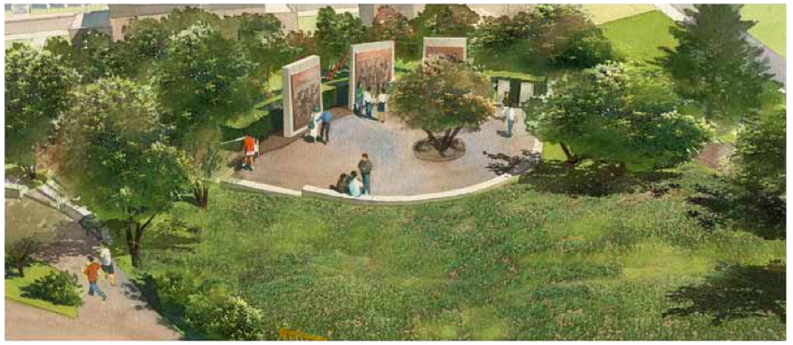
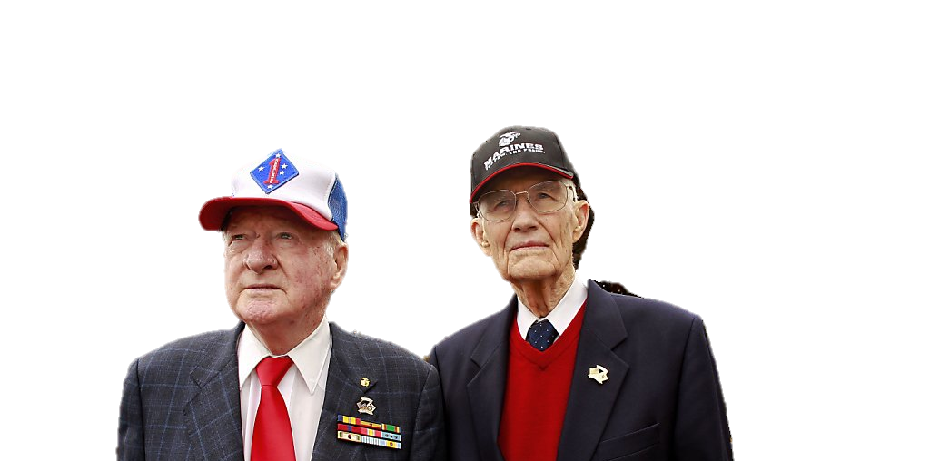
Korea-U.S. Alliance: Korean War Memorials
San Francisco, CA
For more information: kwmf.org

Slide 19
People to People Ties : Korean Int’l Students in U.S.
According to the Institute of International Education,
Korea ranks 3rd in international students in the U.S.
with 91,693 Korean students
in the 2013-14 academic year.

Slide 20
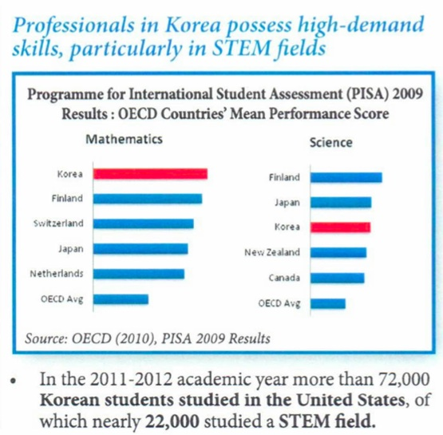
People to People Ties : STEM majors
In the 2013-2014 academic year, more than 91,000 Korean Students are studying in the United States, of which nearby 30,000 (almost 30% of all) studied a STEM field.

Slide 21
People to People Ties : H.R. 1812
15,000
10,500
E-4
5,400
0
H-1B
1,400
H-1B
U.S. set aside 5,400 H-1B visas for nationals of Singapore and 1,400 H-1Bs for Chile when the U.S. agreed to free trade agreements with the two nations. The U.S. even created 10,500 E-3 visas only for Australian professional workers when the U.S. entered a free trade agreement with Australia.

Slide 22
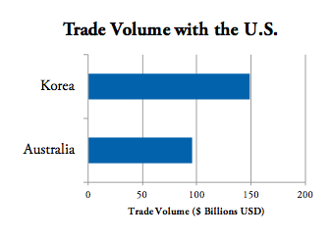
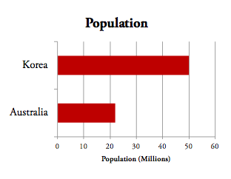
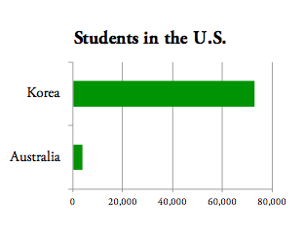
People to People Ties : H-1B for Korea
There are 1.4 million ethnic Koreans living in the United States compared to 89,000 Australians.
Korea has 25 times more students enrolled in American universities than Australia; 91,000 Korean students compared to 3,700 Australians.

Slide 23
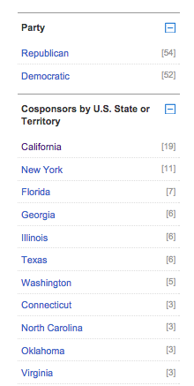
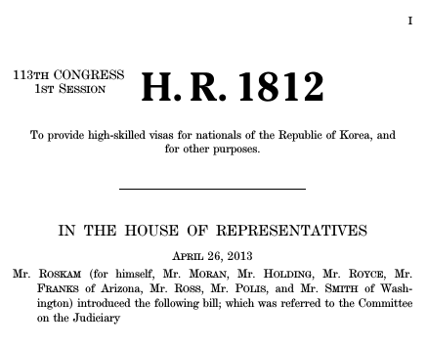
People to People Ties : Professional visas
106 Cosponsors
(54 R, 52D)
as of today

Slide 24
People to People Ties : H.R. 1812
Cosponsor Date Cosponsored
Rep. Royce, Edward R. [R-CA-39] 04/26/2013
Rep. Lofgren, Zoe [D-CA-19] 06/27/2013
Rep. Lowenthal, Alan S. [D-CA-47] 10/16/2013
Rep. Schiff, Adam B. [D-CA-28] 10/22/2013
Rep. Bera, Ami [D-CA-7] 11/13/2013
Rep. Honda, Michael M. [D-CA-17] 12/05/2013
Rep. Valadao, David G. [R-CA-21] 12/10/2013
Rep. Takano, Mark [D-CA-41] 02/26/2014
Rep. McKeon, Howard P. [R-CA-25] 03/04/2014
Rep. McCarthy, Kevin [R-CA-23] 03/05/2014
Rep. Sanchez, Loretta [D-CA-46] 04/03/2014
Rep. Garamendi, John [D-CA-3] 04/09/2014
Rep. Eshoo, Anna G. [D-CA-18] 04/28/2014
Rep. Campbell, John [R-CA-45] 06/19/2014
Rep. Speier, Jackie [D-CA-14] 06/23/2014
Rep. Thompson, Mike [D-CA-5] 07/08/2014
Rep. Nunes, Devin [R-CA-22] 07/14/2014
Rep. Lee, Barbara [D-CA-13] 07/25/2014
Rep. McNerney, Jerry [D-CA-9] 09/10/2014
California
Cosponsors: 113th Congress
Party
Democratic (13)
Republican (6)
To support the Partner with Korea Act (H.R. 1812), visit http://kace.org/h-r-1812

Slide 25
Part 3. KORUS FTA

Slide 26
Korea’s Export Portfolio
Diversified export portfolio
by products and destinations (%, as of 2013)
Export by Products
Export by Destinations
Source: Bank of Korea
Notes:
More importantly, Korea has a well balanced and diversified export portfolio which contributes to our resilience.
We export a range of different but competitive products, and the export destinations are becoming more oriented toward emerging economies.
Such diversification in both products and destinations was a key element that helped us navigate through the recent global financial turmoil.
26

Slide 27
Korea’s Export
Expansion of FTAs reaching far corners of the globe
EU
USA
EFTA
Turkey
Columbia
India
ASEAN
Peru
Singapore
Chile
Effective
Concluded
Source: Ministry of Strategy and Finance
¹ Defined as a nation’s GDP combined with the GDPs of its FTA countries, divided by the world GDP
Notes:
27
Korea’s international trade continues to flourish as we further open our markets through Free Trade Agreements.
We now have FTAs in effect with 46 nations, some of which are the largest markets in the world, including the United States and the European Union.
We are in further negotiations to sign FTAs with 11 countries and economic blocks including China and Canada.
As a result, Korea boasts the 3rd largest economic territory in the world based on the combined GDPs of Korea and our FTA partners.

Slide 28
Asia-Pacific Regional Trade Development
Korea-China FTA
- Wrapping up the first-phase negotiations by agreeing on the
modality at the 7th round held on Sept. 3-5, 2013.
KCJ Trilateral FTA
- Announcement on the start of Trilateral FTA on Nov. 20, 2012
- 2nd round : July 30- August 2, 2013
RCEP(Regional Comprehensive Economic Partnership)
- ASEAN, Korea, Japan, China, Australia, New Zealand and India
- 2nd round : September 23-27, 2013
TPP
- Regular Information sharing since August, 2012
- TPP Ministerial meeting and Summit at APEC

Slide 29
Overall Trade in Goods
Evaluation of the KORUS FTA
On March 15, 2012, KORUS FTA entered into force.
Source: U.S. Census Bureau
Notes:
Bilateral trade between the US and Korea has grown steadily in recent years. This upward trend in trade between our two countries will only grow as a result of the FTA. As this graph shows, both countries are growing together, making the FTA a win-win agreement.

Slide 30
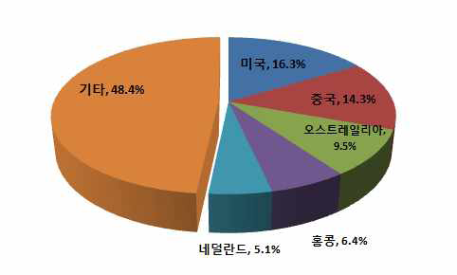
Evaluation of the KORUS FTA
Investment
The U.S. has been No.1 destination for Korea’s FDI.
Korea’s Investment in the US since 1968 through 2012 amounts to $64.3 billion, 19.6% of Korea’s Total FDI abroad($327 billion)
Main field of Korean investment in U.S.
Mining ($16.4 billion, 25.4%)
Manufacturing* ($12.6 billion, 19.6%)
Electronic parts, metal, chemicals
Wholesale/Retail ($12.6 billion, 19.6%)
Finance/Insurance ($8.6 billion, 13.4%)
U.S.
china
Others
Australia
HK
Netherlands
Notes:
Korea’s Investment in the US since 1968 through 2012 amounts to $64.3 billion, 19.6% of Korea’s Total FDI abroad($327 billion)

Slide 31
Evaluation of the KORUS FTA
KORUS FTA Beneficiary Items
 | MAR 15, 2012 – feb 28, 2013
U.S. Exports to Korea | $39.9 billion (-9.1%)
of FTA beneficiary Items | $20.7 billion (+4.1%)
of FTA non-beneficiary Items | $19.1 billion (-20.1%)
U.S. Imports from Korea | $57 billion (+1.4%)
of FTA beneficiary items | $22.4 billion (+10.4%)
of FTA non-beneficiary items | $34.6 billion (-3.6%)
Korea-U.S. Total Trade Volume | $96.9 billion (-3.2%)
*Year-on-year growth rates shown in parentheses
Source: Korea Customs Service
Win-Win (high level and comprehensive trade agreement)
Notes:
Due to KORUS FTA, U.S. exported 4% more of FTA beneficiary items in early 2013, while non-beneficiary items exports were declined about 20%. Likewise, U.S. imports from Korea benefited from KORUS FTA, showing 10% bump on FTA beneficiary items of $22.4billion, which we can call it a Win-win solution for both of our countries.

Slide 32
Evaluation of the KORUS FTA
Services and Investment
Trade in Services : U.S. enjoying trade surplus
U.S. services trade surplus to Korea increased 9.0% in 2012.
(in billions of dollars)
 | 2011 | 2012 | % Growth
U.S. Exports of Services | 16.8 | 18.2 | 8.7%
Korea Exports of Services | 11.0 | 12.0 | 8.5%
Balance on services | 5.8 | 6.2 | 9.0%
Investment
2012: Korea’s FDI in the US ($6.9 billion) - U.S. FDI in Korea (3.7 billion)
Cumulative amount: Korean investment in the US ($64.3 billion) - U.S. investment in Korea (50 billion)
Win-Win (high level and comprehensive trade agreement)

Slide 33
KORUS FTA : Review of Trade Relations
U.S. becomes Korea’s 2nd trading partner in 2013
2011 : 4th (China-Japan-EU-US)
2012 : 3rd (China-EU-US-Japan)
2013 : 2nd (China-US-EU-Japan)
Led by the KORUS FTA, diminishing trade with EU caused by Eurozone Financial Crisis.
Bilateral Trade Trends
US Comparative advantage in Agricultural goods and Services
Trade in High-tech products being intensified
(US → Korea) Semiconductors and Semiconductor manufacturing machinery, Aerospace products & parts, agricultural products
(Korea → US) Motor Vehicle and parts, cellular phones, semiconductors, chemicals

Slide 34
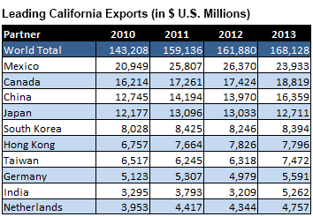
KORUS FTA : KOREA-California
Korea is California’s 5th largest market

Slide 35
KORUS FTA : KOREA-CALIFORNIA
Total Trade Volume : $20.5 billion (1.5% ↑)
- Export : $8.2 billion (2.2% ↓)
- Import : $12.3 billion (4.2% ↑)
California’s Main Export to Korea
- Industrial machinery($1.3 billion), Agricultural products($667 M)
- Navigational, Measuring & medical instruments($504 M)
- Semiconductors and components($411M)
California’s Main Import from Korea
- Semiconductors and components($1.9 billion)
- Motor vehicle($1.7 billion), Iron &Steel($1.3 billion)
- Household appliances($1 billion), Computer Equipment($856M)

Slide 36
KOREA-CALIFORNIA : Exports
California Exports to Korea
Commodity | KORUS FTA Benefit | Mar 2012 – Feb 2013 (Million USD) | % Change (y-o-y)
Oranges (fresh) | (Mar-Aug) 30% → 0% over 7 years (Sep-Feb) 50% → 0% now Out-of-quota remains at 50% | 206.4 | 20% ↑
Almonds (fresh, dried, or shelled) | 8% → 0% now | 133.2 | 69% ↑
Medical and surgical devices | 8% → 0% over 3 or 10 years | 56.9 | 37% ↑
Electrical apparatuses for protecting electrical circuits | 8% → 0% now | 50.5 | 37% ↑
Cherries (fresh) | 24% → 0% now | 38.1 | 84%↑
Source: U.S. Census Bureau
Notes:
During 2012-2013, Orange, one of California’s export items to Korea benefited from KORUS FTA, showing 20% up trend, while its tariff phased out from 30 percent to 0 over seven years. Other beneficiary items of California are Almonds, Medical and surgical devices, and electrical circuits products, Tariffs on these items will phase out from 8% to 0%.

Slide 37
KOREA-CALIFORNIA : Imports
California Imports from Korea
Commodity | KORUS FTA Benefit | Mar 2012 – Feb 2013 (Million USD) | % Change (y-o-y)
Rubber tires for motor vehicles | 4% → 0% over 5 years | 649.3 | 3.1% ↑
Petroleum oil | 52.5 cents/bbl eliminated immediately | 615.1 | 24.5% ↑
Liquid dielectric transformers | 1.6% → 0% now | 90.1 | 12.1% ↑
Heat exchange units | 4.2% → 0% now | 30.6 | 174.8% ↑
Automatic banknote dispensers | 2.6% → 0% now | 30.0 | 49.8% ↑
Source: U.S. Census Bureau
Notes:
The items California is importing from Korea are car tires, petroleum oil, and etc. These are also benefiting from KORUS FTA.

Slide 38
KORUS FTA : KOREA-CALIFORNIA

Slide 39
Success Story: Pelican Products (Torrance, CA)
“At Pelican Products, we have always considered Korea a growth market and have increased our business there consistently for several years. Now, with the implementation of the FTA, we can be more competitive and grow even more quickly. I am truly excited for the possibilities for us in Korea.”
Scott Ermeti, Vice President of International Business Pelican Products, Inc.
Pelican Products manufactures American-made cases and portable lighting equipment designed for max durability and performance in hazardous environments
Industry coverage: aerospace, emergency response, military, oil and gas, etc.
Exports: has exported to Korea for 15+ years and the company opened a Seoul office in 2011.
Now, KORUS FTA Tariff Benefits: : 8% → 0%

Slide 40
KORUS FTA : KOREA-CALIFORNIA

Slide 41
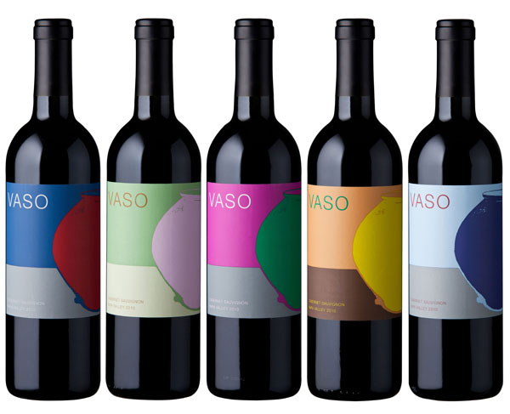
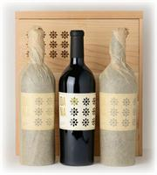
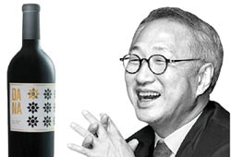
California Wines : Dana Estates from Napa
$1,150
Vaso Series from Dana Estates
“Lotus Vineyard”
"A rich, sensual wine, the Cabernet Sauvignon Lotus Vineyard captures the best qualities of the vintage.” – Robert Parker’s Wine Advocate
“… Dana, would be my pick for the new winery most likely to attain cult status.” – Sommelier Journal
“The winner of the best Napa Cabernet 2008 is a Napa Valley newcomer, Dana Estates.” – The Wine Magazine, No.13

Slide 42
California Wines, Spirits and Beer
Wine: South Korea’s 15 percent tariff will go to zero immediately.
Distilled spirits: South Korea’s tariffs of 15, 20 and 30 percent will be phased out in 5-10 years. Bourbon whisky, currently subject to 20% tariff, will receive an immediate duty-free treatment.
Beer: South Korea’s 30 percent tariff will be phased out in 7 years.
Source: www.ustr.gov/uskoreafta/processed_foods
With Congressman Mike Thompson

Slide 43
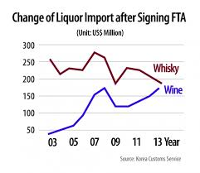
Impact of KORUS FTA on U.S. Wine exports
Change of Liquor Import After Signing FTA (Unit: US$ Million)
With Congressman Mike Thompson
Notes:
For the first year after implementing the FTA between Korea and Chile in 2004, Chilean wine exports to Korea increased by 151.6 percent. Before 2004, Chile’s share of Korean wine market was only 3 percent. After implementing, Chilean wine occupies 20 percent of Korean wine market. U.S. wine exports to Korea were the second behind France until 2004, but Chile took over the second place in 2005 after implementing FTA with Korea.

Slide 44
How to Utilize the KORUS FTA
The KORUS FTA’s utilization rate has grown steadily since its implementation
As of February 2013, 62.1 percent of U.S. exports to Korea and 69.6 percent of Korean exports to the U.S. have benefited from the KORUS FTA
Help SME Utilize the KORUS FTA more
FTA Committees : Minister-level Joint Committee and its 19 sub-committees
Website: USKOREACONNECT.org

Slide 45
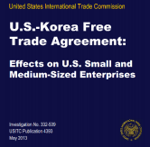
How to Utilize the KORUS FTA: SMEs
Hold Small and Medium Enterprises Working Group meetings
3rd Meeting was held in Washington, D.C. on July 27, 2013
USITC Released a Report on Small and Medium Enterprises on May 2013
“U.S.-Korea Free Trade Agreement:
Effects of U.S. Small and Medium-Sized Enterprise”
“most respondents expressed the belief that the FTA had already proven helpful and would benefit their companies even more over time.”

Slide 46
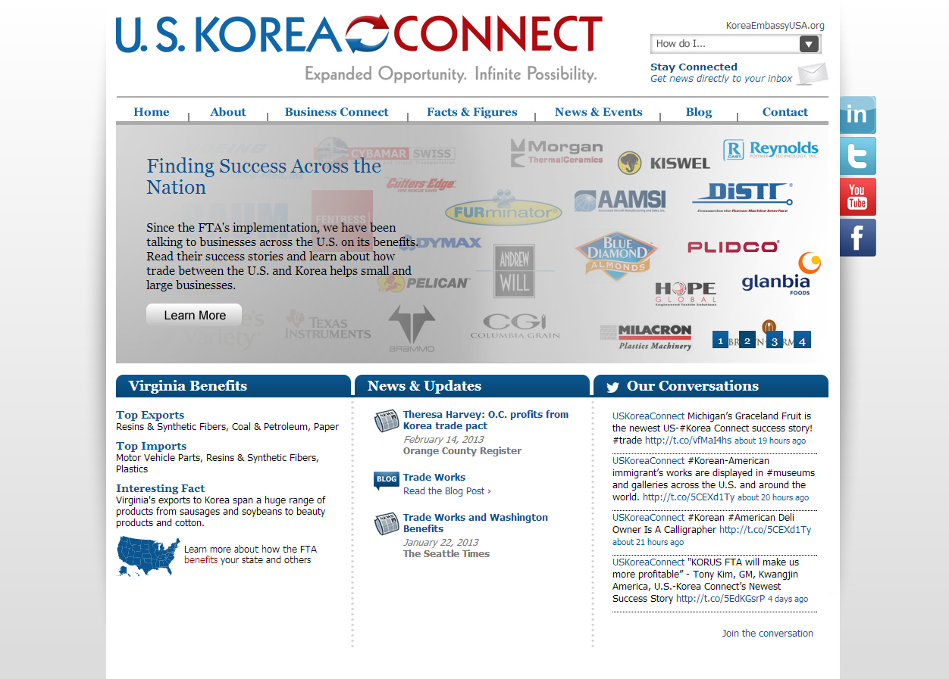
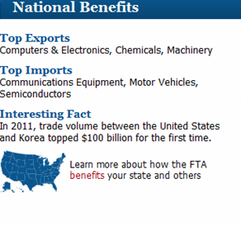
How to Utilize the KORUS FTA
www.USKoreaConnect.org

Slide 47
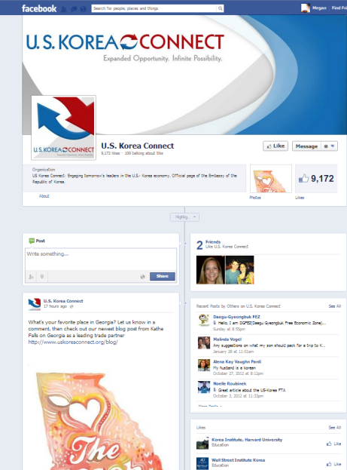
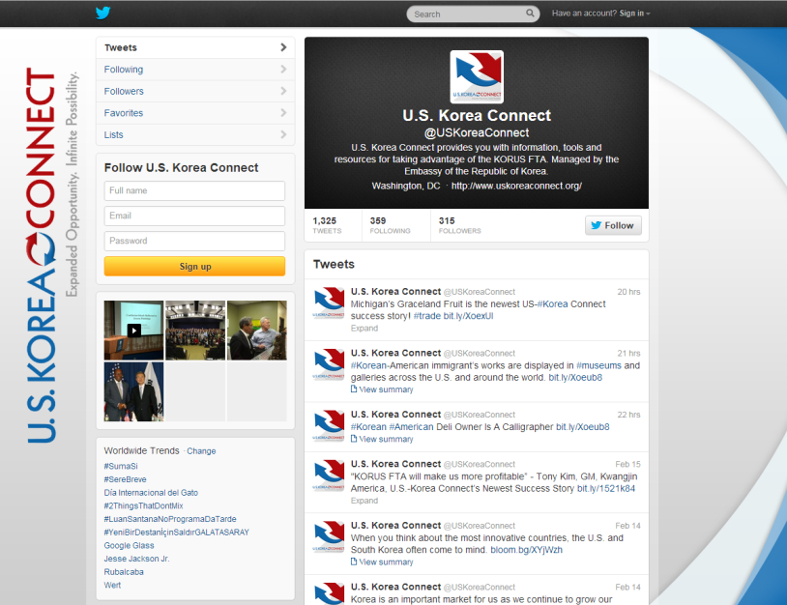
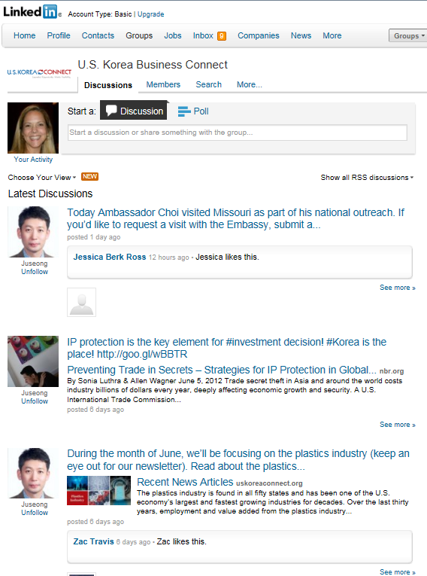
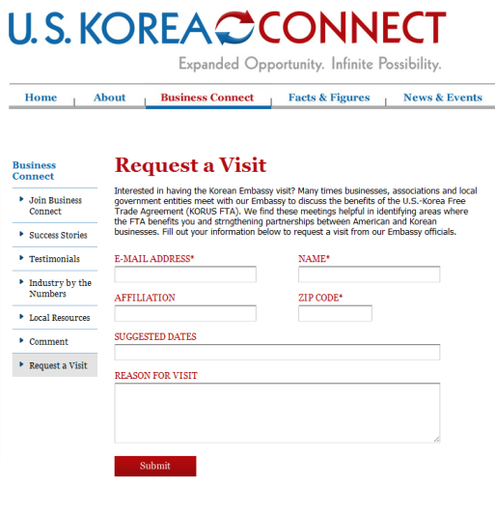
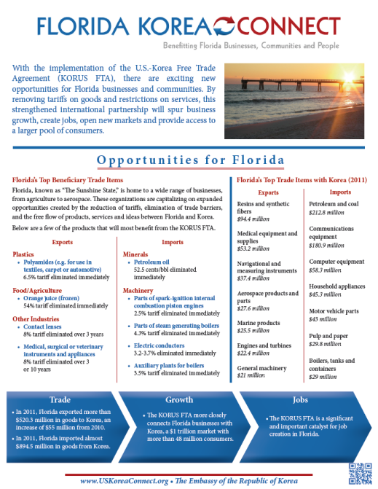
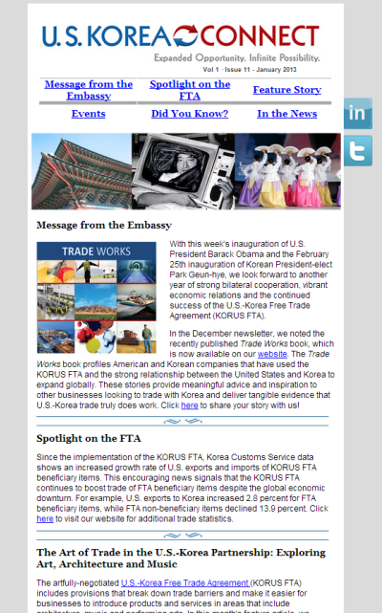
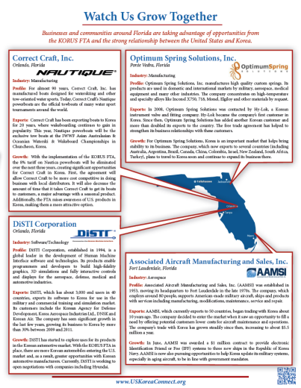
Facebook
Twitter
LinkedIn
Request a Visit
State Fact Sheets
E-Newsletter

Slide 48
Thank you

